Slide 1


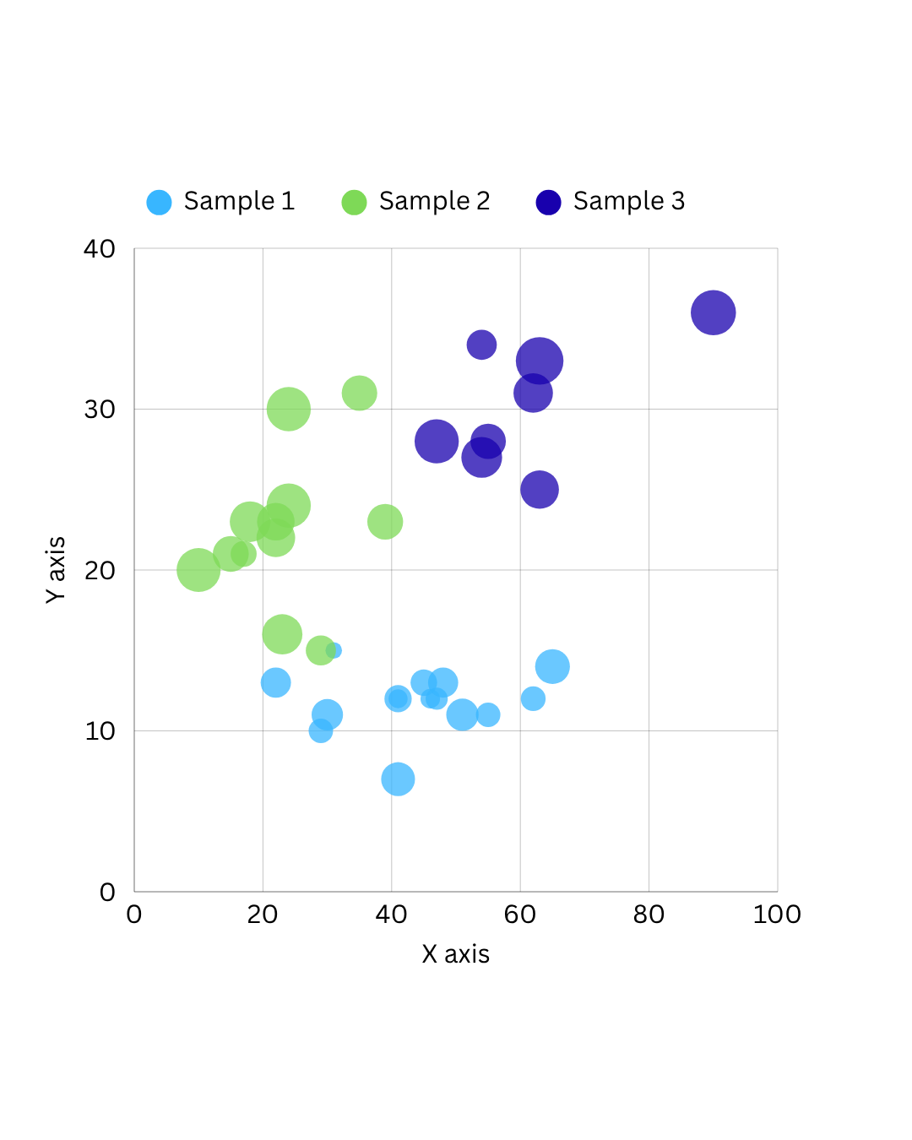
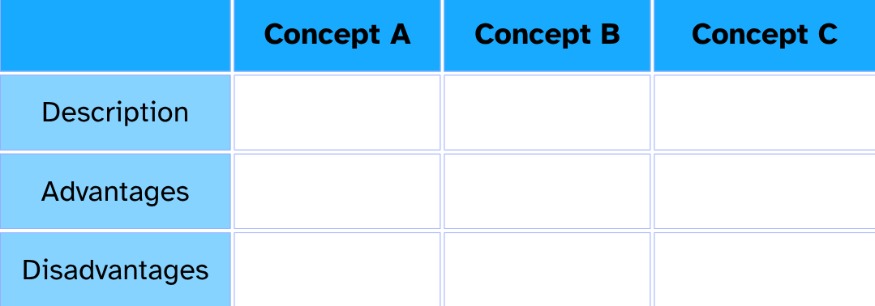




3rd International Conference on Sustainable Transport │ Hotel Admiral, Opatija, Croatia │ 4 - 6 November 2026
Title
Author/s’ names
Affiliation/s
Correspondence (e-mail)
Your logo/s
here (preferably PNG transparent)
Your logo/s
here (preferably PNG transparent)
GUIDELINES
You are required to fit the contents of your contribution in the proposed (green) frames. Place the above elements (title, authors, logo etc.) as specified.
Please consider the clarity and conciseness of your presentation. The poster has to be submitted in both PPT/X and PDF formats.
Stick to the font type for text (Calibri, Normal, dark blue, 28 pts), and headings (Consolas, Bold, light green or light blue or mixed, 40 pts), respectively. If necessary, adopt the font size and text boxes, but make sure it is readable.
The text must be justified. Provide with section headings as it suits you. Suggestions can be found below. Adjust/modify/add frames as needed. Graphical and/or tabular presentations must contain captions (see example below) and sources, if applicable.
Once adopted, remove all the explanatory text. Please do not modify the fixed template elements, including the header, footer, conference logo, and organiser and partner logos.
INTRODUCTION
METHODOLOGY
DISCUSSION
Figure 1. The caption is 20 pt , Calibri.
RESULTS
Table 1. The caption is 20 pt , Calibri.
Organisers:
Partners:
Technical Organisers:
ACKNOWLEDGEMENTS
Project logo
here (preferably PNG transparent)
You can place your acknowledgement here, dark blue, Calibri italic, size 24/28 pt. If there are no acknowledgments, remove this frame and right logo frame.
pfri.uniri.hr | unin.hr
fpz.unizg.hr
vivid-original.com
sutra-conference.com

